Slide 1
Capstone Project Play Store Apps Analysis
By-Kartik Rahi

Slide 2
Points to Discuss:
Agenda.
Data Summary.
Univariate Analysis.
Some Imp Ques.
Correlation Heat Map
Conclusion

Slide 3
Agenda:
To discuss the analysis of Play Store Apps data set from 2014-2018
We’ll be doing analysis of given data set in following ways.
Category wise analysis.
Size wise analysis.
Comparing diff types of app category.
Android version wise analysis.
By doing this we’ll find out key factors to make a app worth making.

Slide 4
Data Summary
Given data set has different columns of variable crucial for app info, some of them are…
App : name of apps are mentioned in this column.
Category : Category of app is mentioned in this column.
Rating : Rating of each app is mentioned in this column.
Review: Numbers of reviews are given in this column.
Size: Size of app is given in this column.
Installs: Total numbers of installs are given in this column.

Slide 5
Data Summary cont…
Type: Weather app is free or paid
Price: If app is paid, then is written.
Content Rating: Who can rate this app divided into (Everyone, Teen, Everyone 10+, Mature 17+,Adult Only 18+,Unrated)
Genres: App category is mentioned.
Last Updated: date given when the app was last updated.
Current Version: current version of app.
Android Ver: App works in which android version.

Slide 6
Category
Size Category
Genres
Android Ver
Categorical
Dataset
Rating
Review
Size
Install
Type
Price
Numeric

Slide 7
Univariate Analysis
By doing Univariate Analysis of given Dataset we wll answer following questions.
PERSENTAGE OF PAID APPS AND FREE APPS
HIGHEST NO OF APP WORKS IN WHICH ANDROID VERSION
WHICH PAID APP HAS HIGHEST REVENUE

Slide 8
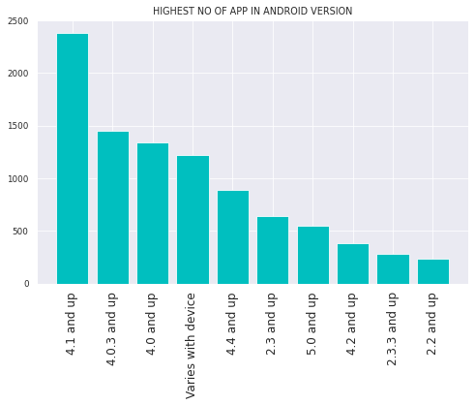
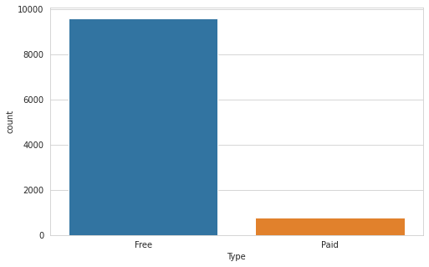
There are 9592 free apps and 765 paid apps.
We can say more than 90% of apps are free.
Highest number of apps works in ‘4.1 and above’
It is because this the is the newest version among them.

Slide 9
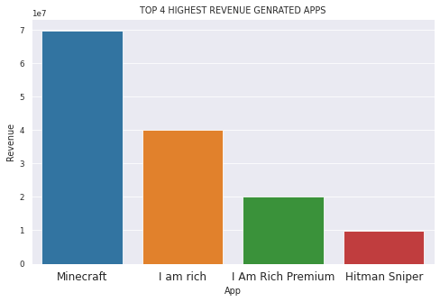
App with the highest revenue is Minecraft
Which is a game, on play store I see most of the paid apps are Games

Slide 10
Category wise Analysis
While doing Category wise Analysis of given dataset we answered following questions.
WHICH CATEGORY OF APP HAS HIGHEST AND LOWEST RATING
WHICH CATEGORY HAS MAXIMUM AND MINIMUM APPS.
WHAT CATEGORY OF SIZED APP HAS HIGHEST INSTALLS
WHICH CATEGORY OF APPS HAS HIGHEST INSTALLS

Slide 11
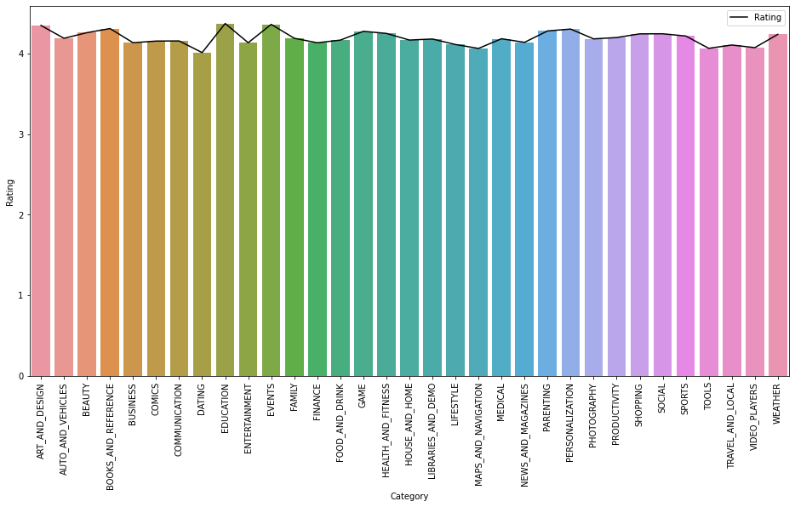
Every app has almost same ratings but if we talk about exact figures, the Education apps has highest app rating, and on the other hand dating apps has lowest rating.

Slide 12
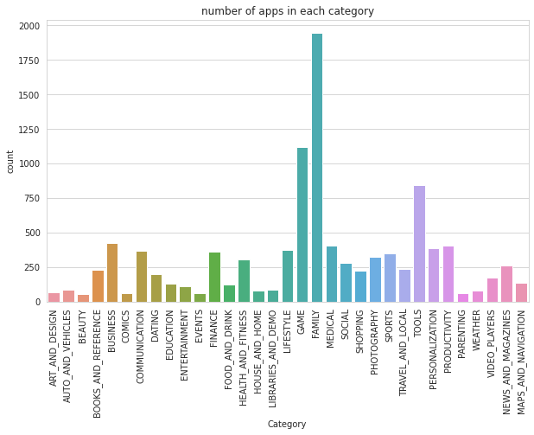
we can see Family category has the highest no. of apps and second highest apps are in Game. minimum apps are in beauty and comics Category.

Slide 13
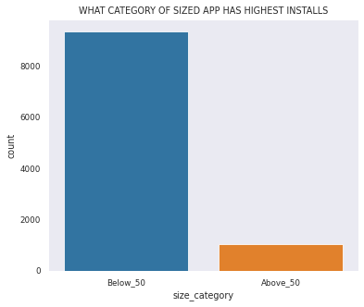
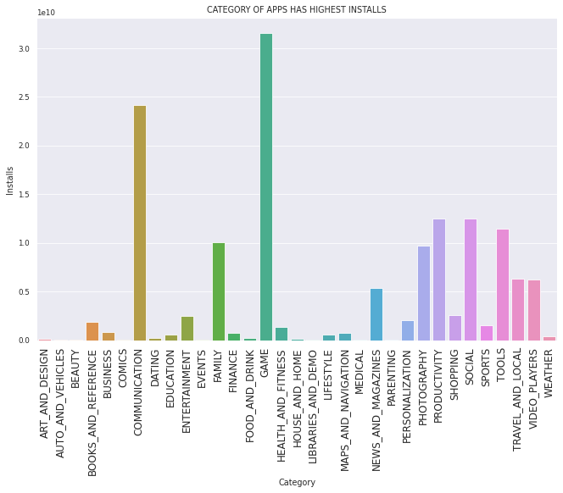
Apps below 50mb has more installs (almost 90%) Above 50mb are 10% installs
Games has the highest installs
and second is Communication app (Because these are the two type of app which are used by every smartphone user

Slide 14
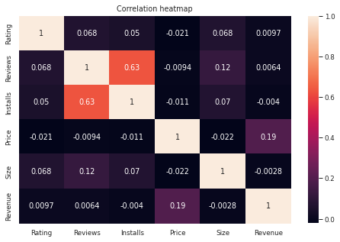
Here is the Correlation heatmap, It shows the co-relation between given columns
Here is Installs and Review are slightly correlated.

Slide 15
Conclusion
90% apps in dataset are free only 10% of apps are paid.
Mostly app works in highest android version.
Highest revenue generating app in dataset is a game named Minecraft.
Family category app has largest number of app
90% of apps are below 50mb that are installed by users.
Games and communication apps has highest installs

Slide 16
Thank You

